Slide 1
Welcome
to the
Old West

Slide 3
Insert Song

Slide 4
God leads the
Israelites out of Eygpt

Slide 5
Shadrach, Meshach,
And Abednego

Slide 6
Opening Prayer

Slide 7
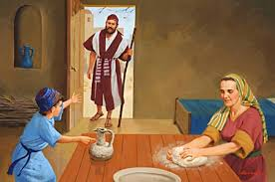
Elijah and the Widow

Slide 8
Oscar
the Western Screech Owl
Helps us remember that
God
Guides Us

Slide 9
Molly
The Sheepdog
Helps us remember that
God
Protects Us

Slide 10
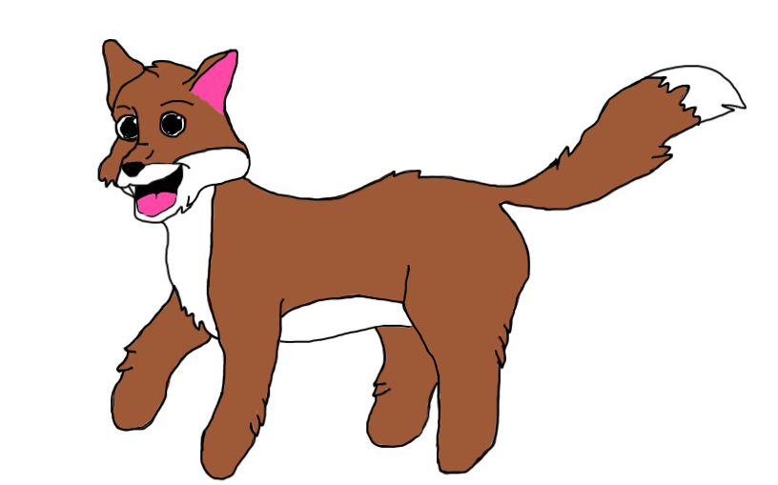
Rascal The wolf
Helps us remember that
God
Provides for us

Slide 11
Insert Song

Slide 12
Stations

Slide 13
the
Old West

Slide 15
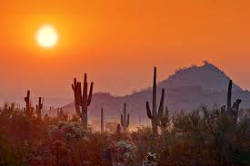
Promised Land
Skit

Slide 16
Insert Song

Slide 18
Our
Mission

Slide 19
Our
Offering

Slide 20
Insert Song

Slide 21
the
Old West

Slide 23
Welcome
to the
Old West

Slide 24
Insert Song

Slide 25
Elijah and the Widow

Slide 26
?
?
Marvelous
Guessing Game
?
?
?
?
?
?
?
?

Slide 27
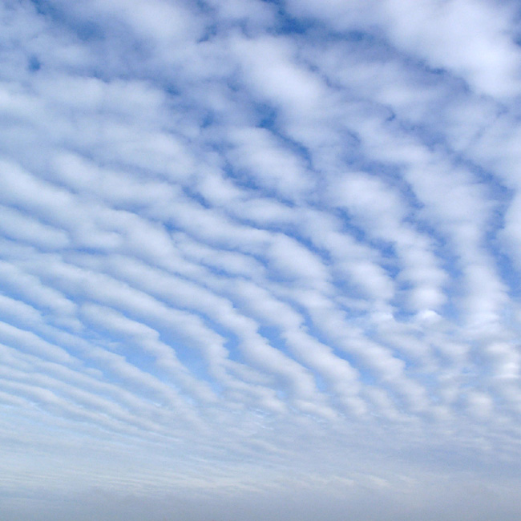
Our Father who art in heaven,
Hallowed be thy name.
Thy kingdom come,
Thy will be done
on earth, as it is in heaven.
Give us this day our daily bread.
And forgive us our trespasses,
as we forgive those who trespass
against us.

Slide 28
And lead us not into temptation,
but deliver us from evil:
For thine is the kingdom, and the power, and the glory, for ever and ever. Amen.

Slide 29
Insert Song

Slide 30
Welcome
to the
Old West

