Slide 1
Welcome
to the
Old West

Slide 3
Insert Song

Slide 4
God leads the
Israelites out of Eygpt

Slide 5
Opening Prayer

Slide 6
Shadrach, Meshach,
And Abednego

Slide 7
Oscar
the Western Screech Owl
Helps us remember that
God
Guides Us

Slide 8
Molly
The Sheepdog
Helps us remember that
God
Protects Us

Slide 9
Insert Song

Slide 10
Stations

Slide 11
the
Old West

Slide 13
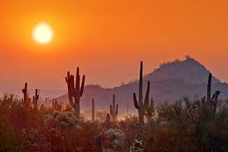
Promised Land
Skit

Slide 14
Insert Song

Slide 16
Our
Mission

Slide 17
Our
Offering

Slide 18
Insert Song

Slide 19
the
Old West

Slide 21
Welcome
to the
Old West

Slide 22
Insert Song

Slide 23
Shadrach, Meshach,
And Abednego

Slide 24
Egg Drop
Experiment

Slide 25
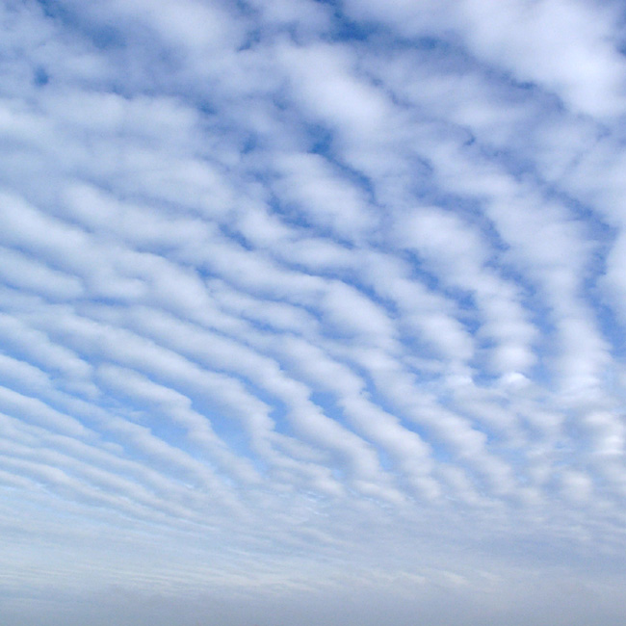
Our Father who art in heaven,
Hallowed be thy name.
Thy kingdom come,
Thy will be done
on earth, as it is in heaven.
Give us this day our daily bread.
And forgive us our trespasses,
as we forgive those who trespass
against us.

Slide 26
And lead us not into temptation,
but deliver us from evil:
For thine is the kingdom, and the power, and the glory, for ever and ever. Amen.

Slide 27
Insert Song

Slide 28
Welcome
to the
Old West

