Slide 1
Welcome
to the
Old West

Slide 3
Insert Song

Slide 4
Opening Prayer

Slide 5
God leads the
Israelites out of Eygpt

Slide 6
Oscar
the Western Screech Owl
Helps us remember that
God
Guides Us

Slide 7
Insert Song

Slide 8
Stations

Slide 9
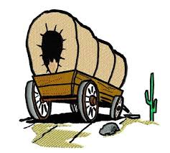
the
Old West

Slide 11
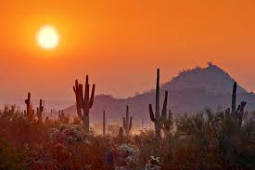
Promised Land
Skit

Slide 12
Insert Song

Slide 14
Our
Mission

Slide 15
Our
Offering

Slide 16
the
Old West

Slide 18
Welcome
to the
Old West

Slide 19
Insert Song

Slide 20
God leads the
Israelites out of Eygpt

Slide 21
Insert Constellation Video

Slide 22
How does God guide us?

Slide 23
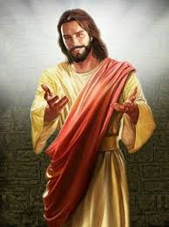
Does God provide a
special person to guide us?

Slide 24
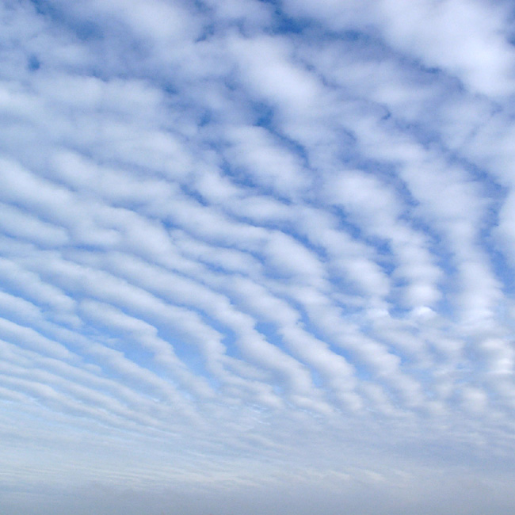
Our Father who art in heaven,
Hallowed be thy name.
Thy kingdom come,
Thy will be done
on earth, as it is in heaven.
Give us this day our daily bread.
And forgive us our trespasses,
as we forgive those who trespass
against us.

Slide 25
And lead us not into temptation,
but deliver us from evil:
For thine is the kingdom, and the power, and the glory, for ever and ever. Amen.

Slide 26
Insert Song

Slide 27
Welcome
to the
Old West

